Slide 1
Describe a typical development lifecycle and QA’s role within the various stages.
Categorise bugs by type using common terminology.

Slide 2
Development Lifecycle
Concept & Design
usually no testing required
QA Manager may evaluate a potential test plan
Production/Prototype
Some production testing may be required
Often, developers test their own or each others code.

Slide 3
Development Lifecycle
Alpha
feature complete, placeholder assets
production testing
Closed Beta
QA testing, often including invited outsiders
Can be several stages of invites

Slide 4
Development Lifecycle
Open Beta
QA testing, including any willing outsiders
sometimes used as a demo
useful feedback through metrics
Compatibility, Usability, Performance all tested
Gold/Live

Slide 5
Bug Categories
Visual
Audio
Level Design
AI
Physics
Stability
Performance
Networking
Compatibility

Slide 6
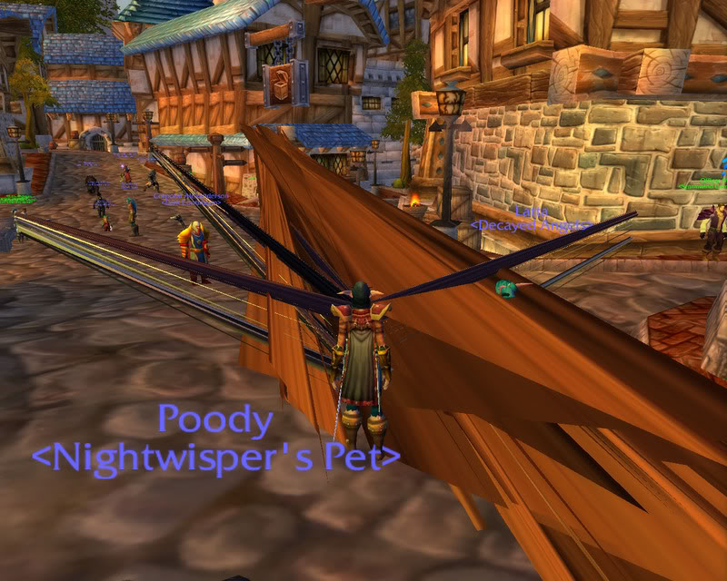
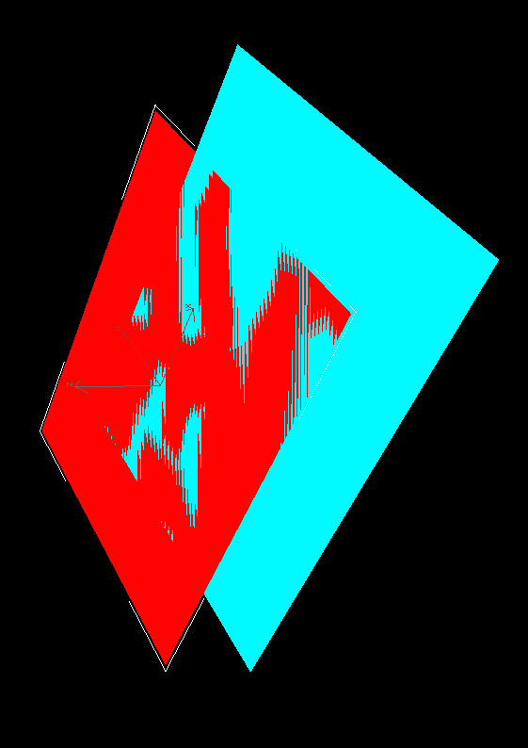
Visual
World of Warcraft
Clipping
geometry pokes through
Z-fighting
Tearing
oft. performance related
Missing/Misaligned Textures
Visible Artefact

Slide 7
Audio
Drop
Skipping
Distortion
Missing or incorrect sounds
Volume Mix

Slide 8
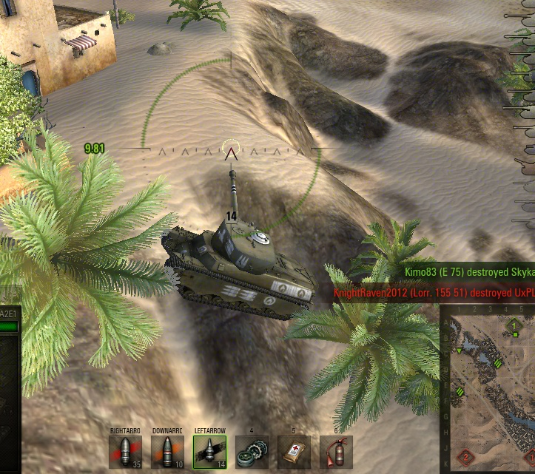
Level Design
Stuck
Sticky
Invisible Wall
Missing Geometry
Hole
World of Tanks

Slide 9
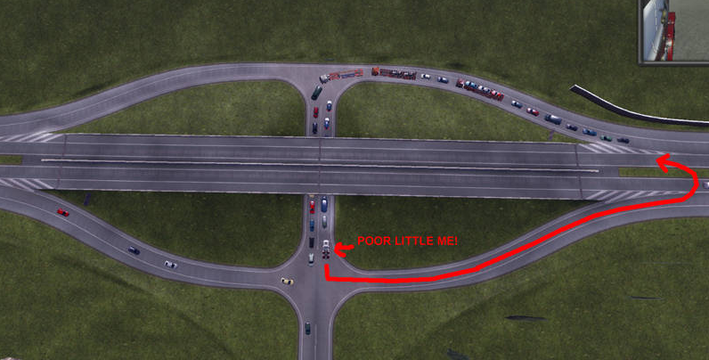
Artificial Intelligence
Pathfinding
Can be caused by level errors as well as bad AI
Behaviour
Choice of target
Choice of action
Euro Truck Simulator 2

Slide 10
Physics
Collisions
Dynamic behaviour
Destruction

Slide 11
Stability
Freeze
Crash
CTD (Crash to Desktop)
Loading
eg. failed level transition

Slide 12
Performance
Frame rate
Acceptable frames per second (fps) depends on platform or genre, but usually 30 or 60fps.
can be difficult to fix if you don’t keep tabs on it during development
Load / Installation time

Slide 13
Compatibility
Problem for PC and Mobile, not so much for consoles.
Video Card/GPU
Controller
Operating System (inc version)

Slide 14
Networking
Failed or Dropped connection
Unaccepted Invitation
Lag
symptom of underlying problem e.g. dropped packets, using too much bandwidth

